Slide 1
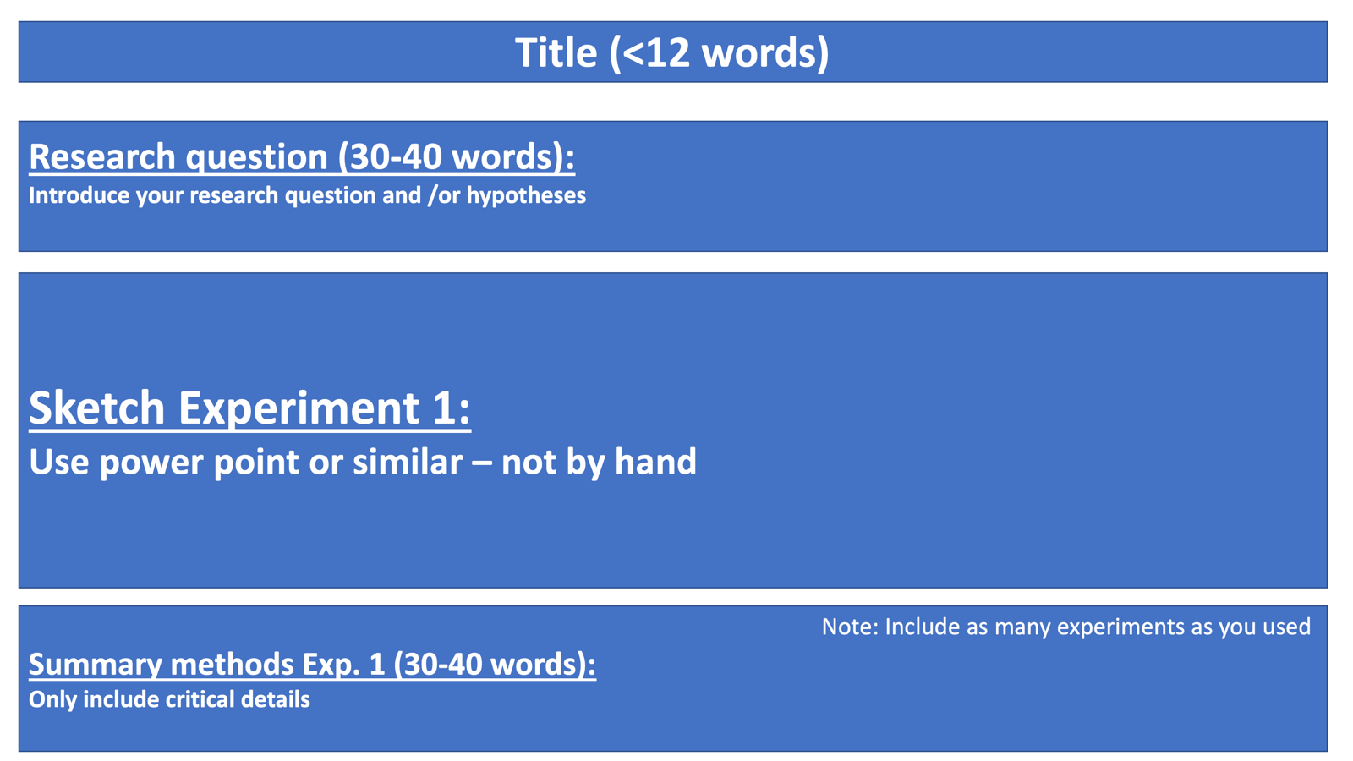

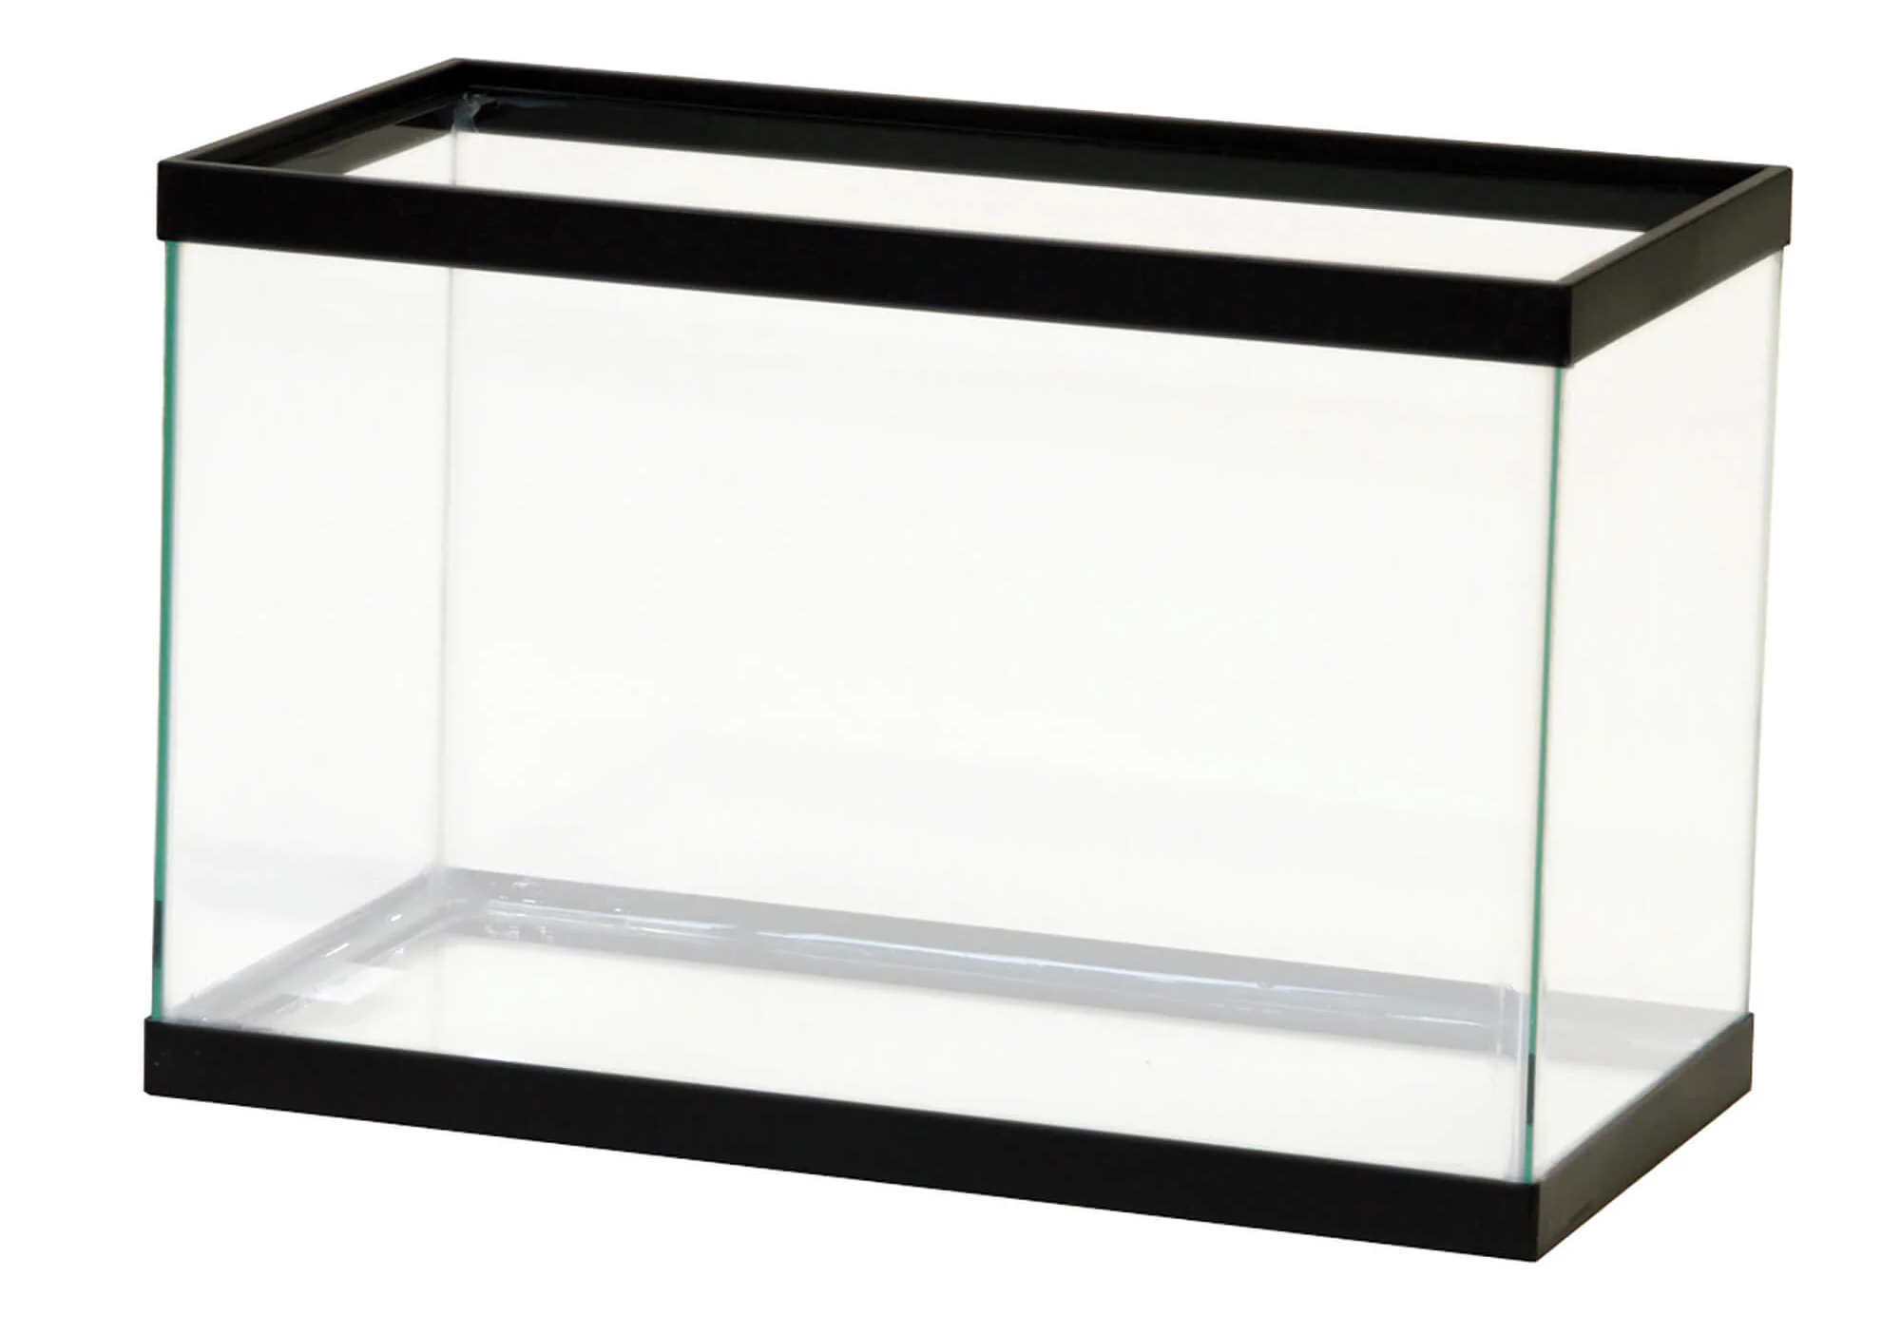

Impacts of Antifouling paint on Hemigrapsus oregonensis and their stress physiology response
How does antifouling paint, commonly used on marine equipment, alter stress levels in Hemigrapsus oregonensis determined through righting time, lactate, and triglyceride levels?
4cm^2
16cm^2
64cm^2
x5
x5
x5
Methods - Righting time data was collected by dropping crabs on their backs and recording how long it took them to right themselves with a stopwatch. Triglyceride and lactate levels were determined by hemolymph extraction.

Slide 2
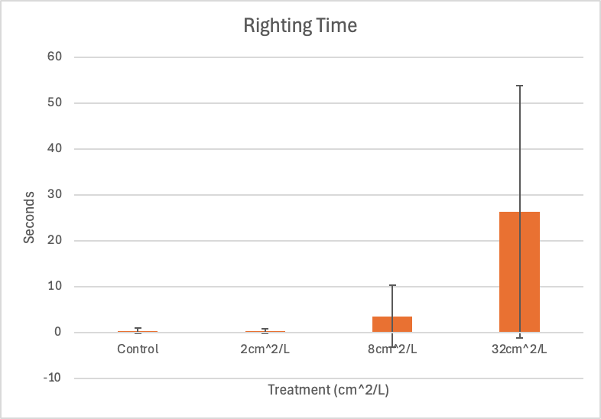
Results
Results Analysis :
Bar graphs for each parameter comparing the means for each treatment, stdev error bars included
Run t-test comparing the means of each treatment against the control
Determine significance with p-values

